Slide 1
White-Rodgers
Universal Heat Pump Defrost Control
47D01U-843

Slide 2
Market and Product Overview

Slide 3
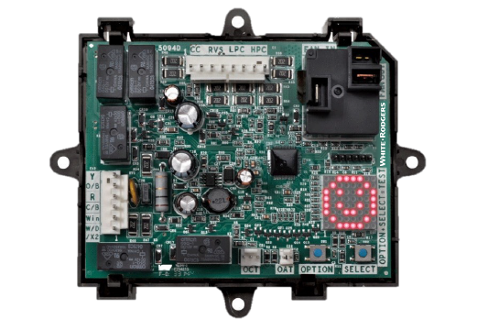
Introduction
  The 47D01U-843 Universal Heat Pump Defrost Control is
  the first microprocessor-based universal replacement defrost controller intended for single stage heat pump systems.
  Supports two defrost modes:
    Demand Defrost: initiates when a set difference between the outside coil and air temperature is reached
    Time/Temp Defrost: based on a field set temperature
    and run time
  Supports both O/B Reversing Valve options (Heating/Cooling)
* Note: Level of features depends upon model being replaced.

Slide 4
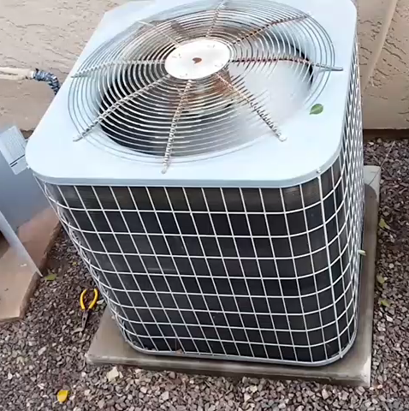

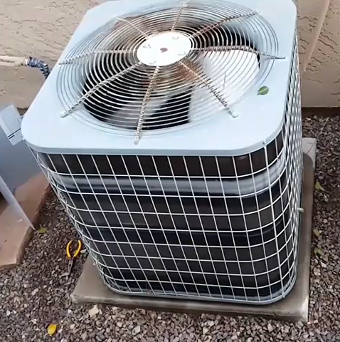
Demand Defrost
The White-Rodgers Defrost Timer Control combines an electronic timer with temperature sensors to identify when an outdoor coil is frozen or not providing heat efficiently. This sends the unit into defrost mode to remove frozen water that restricts airflow through the outdoor coil.
Demand Defrost
Time Defrost
Demand Defrost
    A Timer initiates the Defrost mode every 30 to
    120 minutes. If / when the Coil Temperature Sensor is warm enough, it returns to the Heat mode.
    An Outdoor Temperature Sensor and Coil Temperature Sensor monitors the system. When it determines there is frost build up, it will initiate the Defrost mode.
Defrost every ½-2 hours
Defrost only when needed

Slide 5
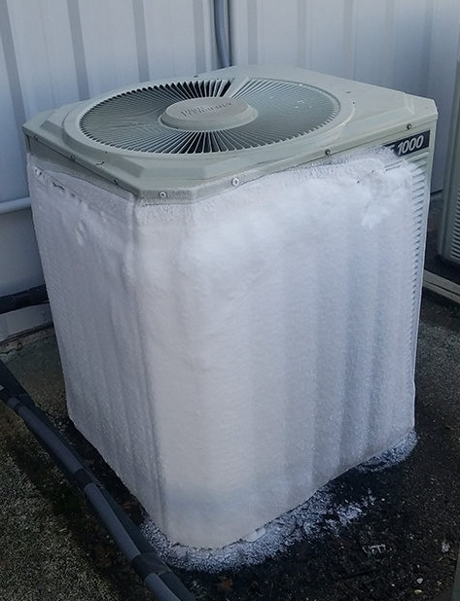
Eliminate Ice Build Up
  When the outdoor coil is colder than the air during heating mode, it causes the air going through the coil
  to give up its heat.
    Moisture in the air condenses on the surface of the coil and freezes over time, restricting airflow through the coil
    As the moisture freezes to ice, the heat-pump becomes more inefficient and cannot properly absorb heat to be released into the conditioned space
    In order to melt the ice and return to proper airflow, the unit goes into “Defrost” mode by running hot refrigerant through the coil
    The frequency of ice build-up depends on outside air temperature and humidity

Slide 6

Top Line Features and Benefits
This award-winning heat pump control replaces hundreds of OEM defrost controls while offering premium features that benefit both the contractor and the end-user.
Increase Efficiency
Feature | Function
Demand Defrost Option | Reduces energy usage compared to Time/Temp cycles
AUX Heat Lockout | Limits use above set temperature (No accessory kit needed)*
Low Temp Compressor Lockout | Low Temp Compressor Lockout Limits heat pump usage at inefficient temperatures
Easy to Install / Service
Feature | Function
Versatile Mounting Tray | One, universal part of all systems
Pre-Configured, Adjustable Settings | Select from OEM pre-sets or customize
Test Mode | Verify operation at any temperature
8x8 Matrix LED Display | Immediate, easy visualization of system status and faults
O/B Reversing Valve | Supports energizing in both heating and cooling
* Value add for CA Title 24, by locking out AUX heat until below 40°
US Patents 9,037,303 • 9,412,328 9,830,887 • 9,064,345

Slide 7

47D01U-843 Competitive Comparison
Feature | White-Rodgers 47D01U-843 | Brand X DB7110U
Board Cross References | 430+ | 260
Readable Display | 8x8 Matrix | 4x7 Segmented LED
Multi-position Display can be rotated in settings |  | X
Display Shows Status & Fault Codes, has Fault recall
Set-up / Fault Code Label for quick reference |  | X
Select from OEM pre-sets to match factory |  | X
Menu configurable for Demand or Timed Defrost |  | (Demand-enabled)
Menu configurable for Pressure Switch enable/disable |  | X (non-supplied jumpers required)
Auxiliary Heat & Compressor Lockout can be used in Demand & Timed Defrost |  | X (demand only)
Wiring flags supplied for wiring ID installation ease |  | X
Reversing Valve delay for quieter Defrost
Menu Config “O” or “B” Reversing Valve
Air and coil sensors
Strain-proof sensor connectors |  | X

Slide 8

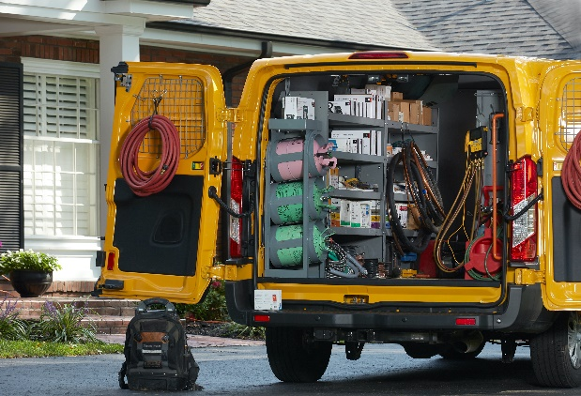
Business Case
  Universal Heat Pump Defrost Control offers contractors a unique opportunity to deliver a product with direct savings to their customers. By eliminating wasteful run time from traditional time-based defrost controls, this control offers immediate savings to homeowners, and a great sell-in opportunity to technicians.
Heat Pump Market Potential
25M Units Installed Base | 2.9M Units | 250K Defrost Controls
Every Unit has a Defrost Control | Heat pump growth market* 20% in 1997 35% in 2018 | Estimated annual service market
By upgrading to a Demand Defrost Option, homeowners reduce energy usage compared to Time/Temp Defrost Control, saving them $$$.

Slide 9


Testimonials
  “Very easy to install and to setup. Make my heat-pump work like a charm.”
    January 20, 2016 – Denis
  “Excellent product if you want to save money on
  your heat pump that has a dumb timer based defrost. Installed this in under an hour and now have demand defrost on my two-year old Goodman unit. Went from hourly defrosts of nearly no build up to a defrost every
  4 hours on a dry day and about every 45 minutes during a freezing rainstorm. If in doubt... Buy it!”
    January 25, 2017 – S. Begin
  “Extremely easy to install would buy again.”
    December 13, 2018 – D. Miller
  “Programming the settings was simple and I set it for low energy use. It’s operating beautifully.”
    January 4, 2019 – U. Huren

Slide 10
Technical Overview

Slide 11
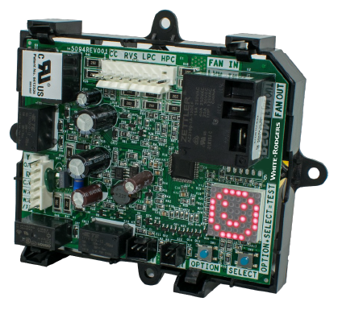
Introduction
  A wide range of existing Time Defrost Controls can be replaced by the White-Rodgers 47D01U-843 Defrost Control, increasing the efficiency of existing systems by shifting system operation from time-based to demand-based.
Defrost Control | Defrost Cycle Timing
Demand Defrost Option | Demand Defrost Option Defrost cycles limited to on-time delivery, based on need*
Time Defrost Option | Defrost cycles generated on pre-set time schedule
* Demand defrost WILL run one cycle every 6 hours to ensure that oil viscosity is appropriate to return to compressor.

Slide 12
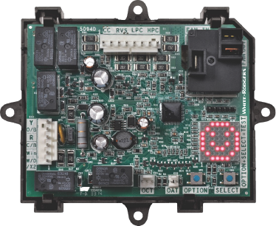
Applications
Single Stage Heat Pump Systems,
PSC Condenser Motor
Selectable /
Adjustable Options
    With or without AUX Heat
    Low Temp compressor lockout
      9 compressor temp settings, for compressor shutoff
    Dual fuel compatible
    Selectable Brownout protection with Random Time Start Delay
    Provides AUX heat lockout
      With outdoor temperature sensor – included in kit
    Demand Defrost
      Non-adjustable 6 hour cycle to ensure that oil viscosity is appropriate to return to compressor
    Time/Temp Defrost
      30-120 minute adjustable cycle time*
    Selectable “O” or “B” reversing valve
    Reversing valve shift delay (0,12,30 seconds)
    Short cycle time (0,3,5 minutes)
* Upgradable Time/Temp Defrost systems can be upgraded to Demand Defrost, resulting in greater energy efficiency

Slide 13

Specifications
Input Voltages
    208/240 VAC 50/60 Hz (Primary)
    24 VAC 50/60 Hz (Secondary)
Input Current Outdoor Fan Max
    0.5 HP @ 240 VAC Motor
    0.125 @ 120 VAC Motor
    10mA @ 24 VAC, ECM Motor
Operating Range
    Temperature, -40°F to +150°F
    Humidity, 0 to 95% Rh, non-condensing

Slide 14








Compatible with top manufacturer heat pumps
Choose from 8 pre-configured OEM Equipment Brands:
Display | OEM | Defrost Type | Defrost Cycle Time | Short Cycle Time | RV Power | RV Shift Delay | Max Defrost Time | Defrost Enable Coil Temp | Defrost Terminate Coil Temp.
 | Carrier | T/T | 90 min | 5 min | O | 0 sec | 10 min | 30° | 65°
 | Goodman | T/T | 30 min | 5 min | O | 30 sec | 10 min | 35° | 70°
 | Lennox | Demand | n/a | 5 min | O | 30 sec | 14 min | 35° | 50°
 | Trane | Demand | n/a | 0 min | O | 12 sec | 14 min | 36° | 50°
 | Rheem* | Demand | n/a | 5 min | B | 30 sec | 14 min | 35° | 70°
 | York | Demand | n/a | 5 min | O | 30 sec | 8 min | 31° | 80°
 | Nordyne | Demand | n/a | 3 min | O | 30 sec | 14 min | 35° | 70°
 | Factory Default | Demand | 30 min | 5 min | O | 30 sec | 14 min | 34° | 70°
  Additional adjustments i.e. setting demand defrost or changing the defrost enable & terminate coil temp are customizable in the options portion of programming that utilizes the 8x8 LED Matrix, the “option”, and “select” buttons

Slide 15
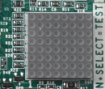
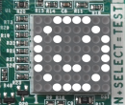
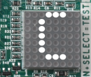

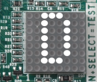
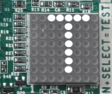
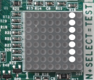
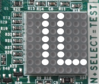
Troubleshooting
Display | Condition | Comments for Troubleshooting
 | Power Up | Normal Operation During Power up all LED’s on the 8 x 8 matrix display will light up
 | Standby | Normal operation with power and no active call
 | Running in Cooling Mode | Steady on represents an active call for cooling. Blinking represents short cycle or other time delay active with a compressor demand.
 | Running in Heating Mode | Steady on represents an active call for heating. Blinking represents short cycle or other time delay active with a compressor demand.
 | Running in Defrost Mode | Represents the control in defrost mode
 | Field Test Mode | Displayed till the OPTION+SELECT buttons are pressed Applicable to short cycle bypass as well as forced defrost field test mode
 | LPS Trip | Low Pressure switch must be connected to the Universal Heat Pump Defrost control and an option selected from the menu. If low pressure switch opens during an active call the system will shut down. Normal operation will resume after switch is closed
 | LPS Lockout | If the Low-Pressure switch opens 3 times the control will lockout

Slide 16







Troubleshooting cont.
Display | Condition | Comments for Troubleshooting
 | HPS Trip | High Pressure switch must be connected to the Universal Heat Pump Defrost control and an option selected from the menu. The pressure switch is normally closed. An open condition will trigger this error. Normal operation will resume after the switch is closed.
 | HPS Lockout | If the High-Pressure switch opens 3 times the control will lockout.
 | Air Sensor Fault | Outdoor Air Temperature Sensor (OAT) is at fault. Possible bad connection
 | Coil Sensor Fault | Outdoor Coil Temperature Sensor (OCT) is at fault. Possible bad connection
 | Consecutive Defrost | Two Consecutive Defrosts Terminated on Maximum Defrost Time
 | Low Control Voltage | Possible 24 VAC brownout condition
 | Control Failure | Replace Control

Slide 17
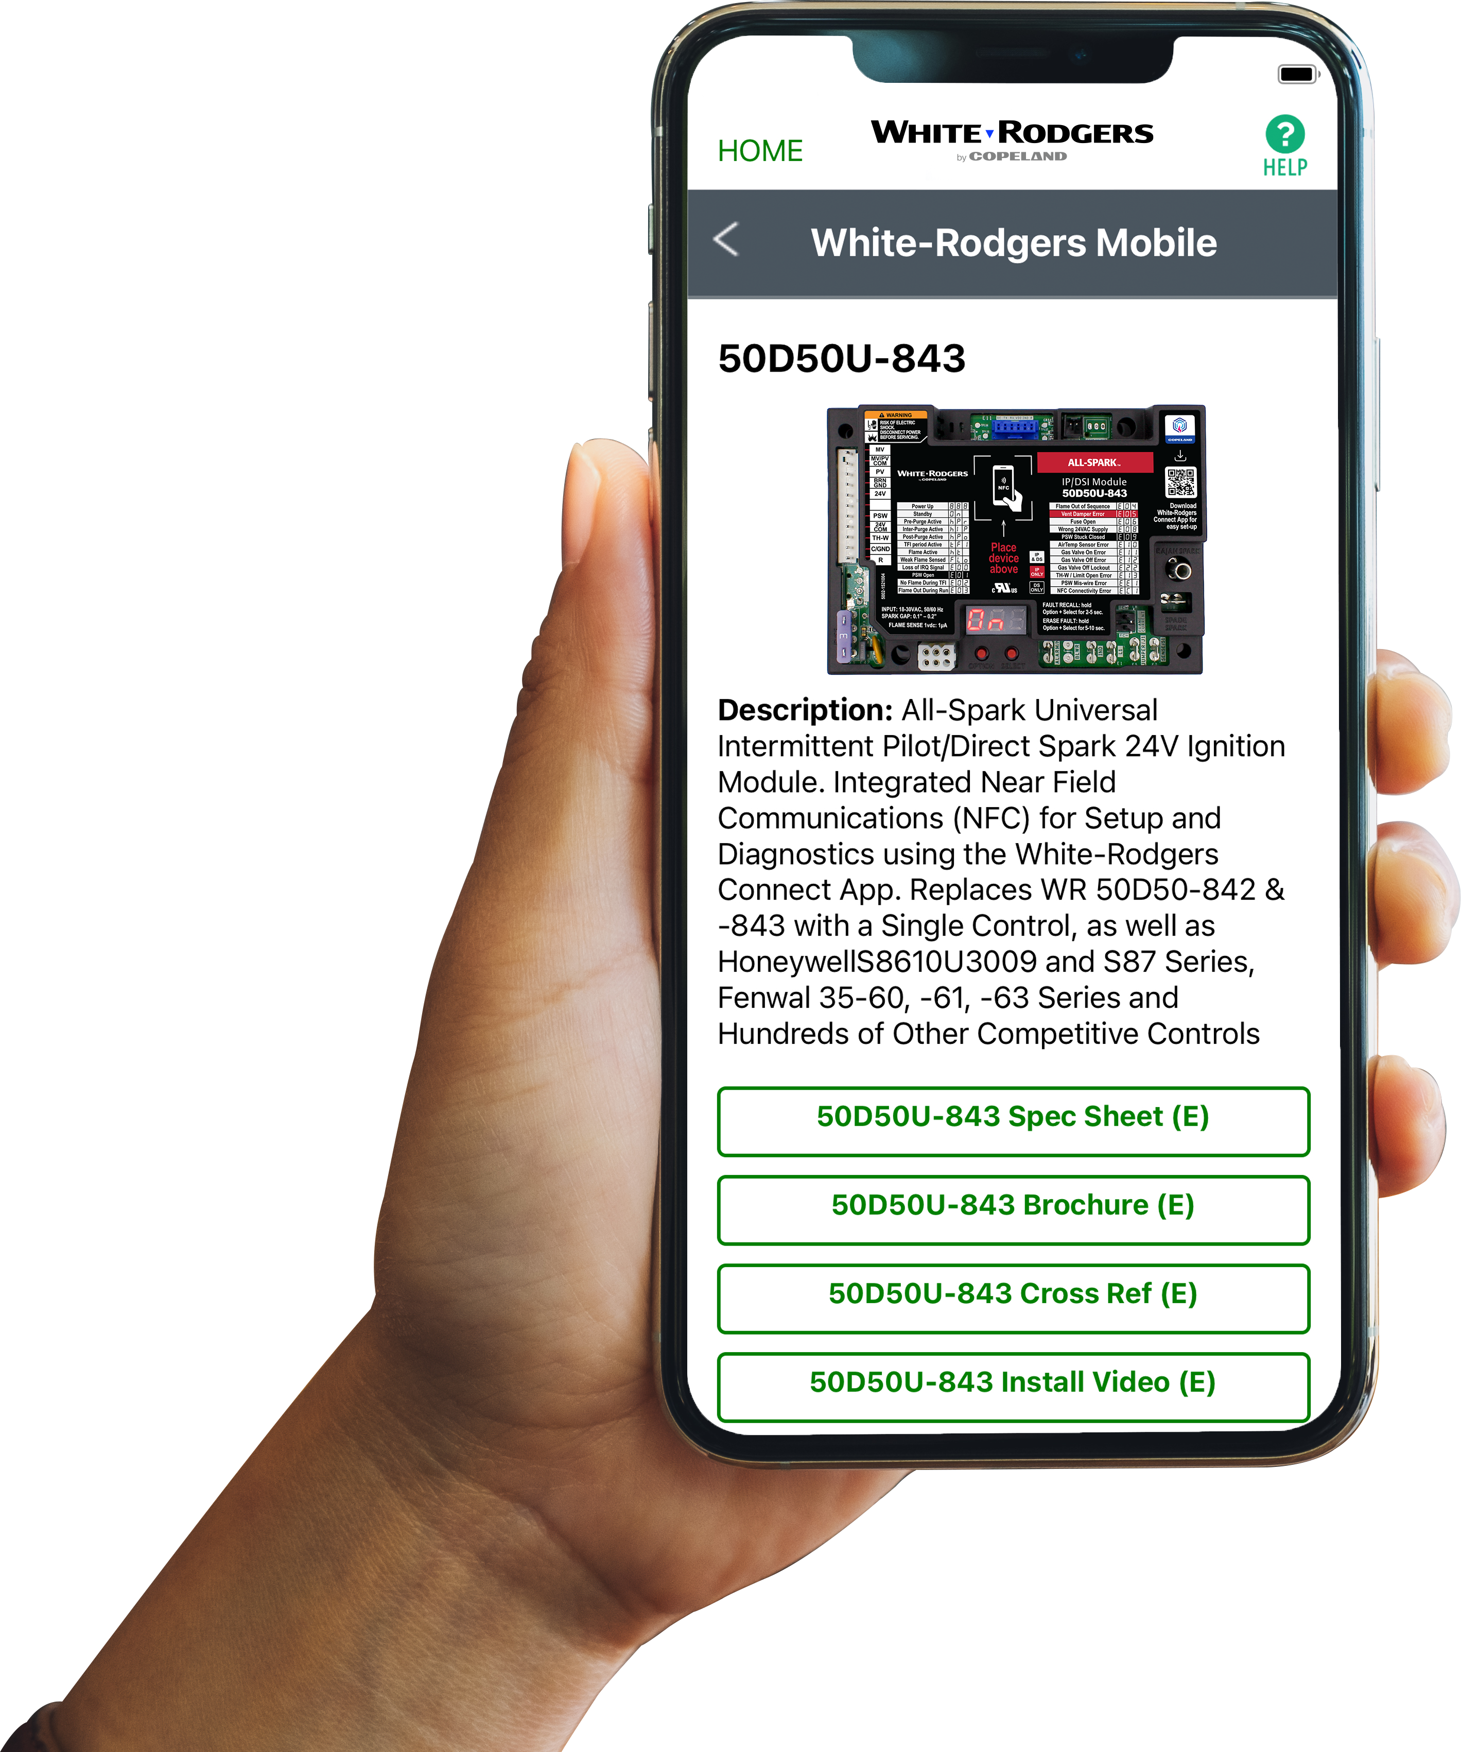




Comprehensive Cross Reference & Product Information
Find the right part while on the job.
  Your on-the-go resource for:
  Complete cross reference
  Product information and spec sheets
  Installation information and videos
  Wiring diagrams
  Select product by features
  Priority technical support
  WR Mobile App
  Search for “WR Mobile” in both Apple
  and Google Play Stores
  Desktop Version
  Access the online version HERE
Search by OEM, Competitor and White-Rodgers part numbers.

Slide 18
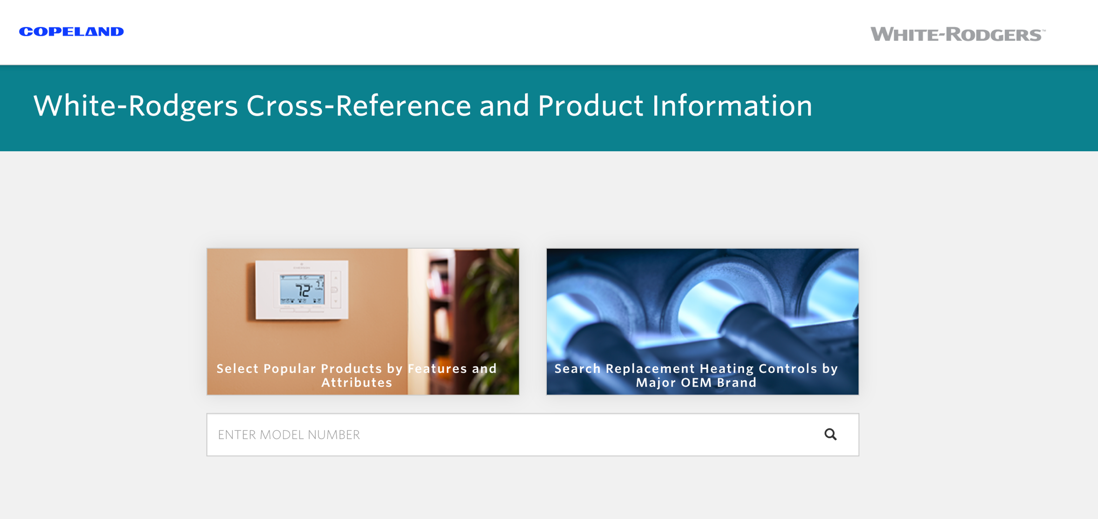
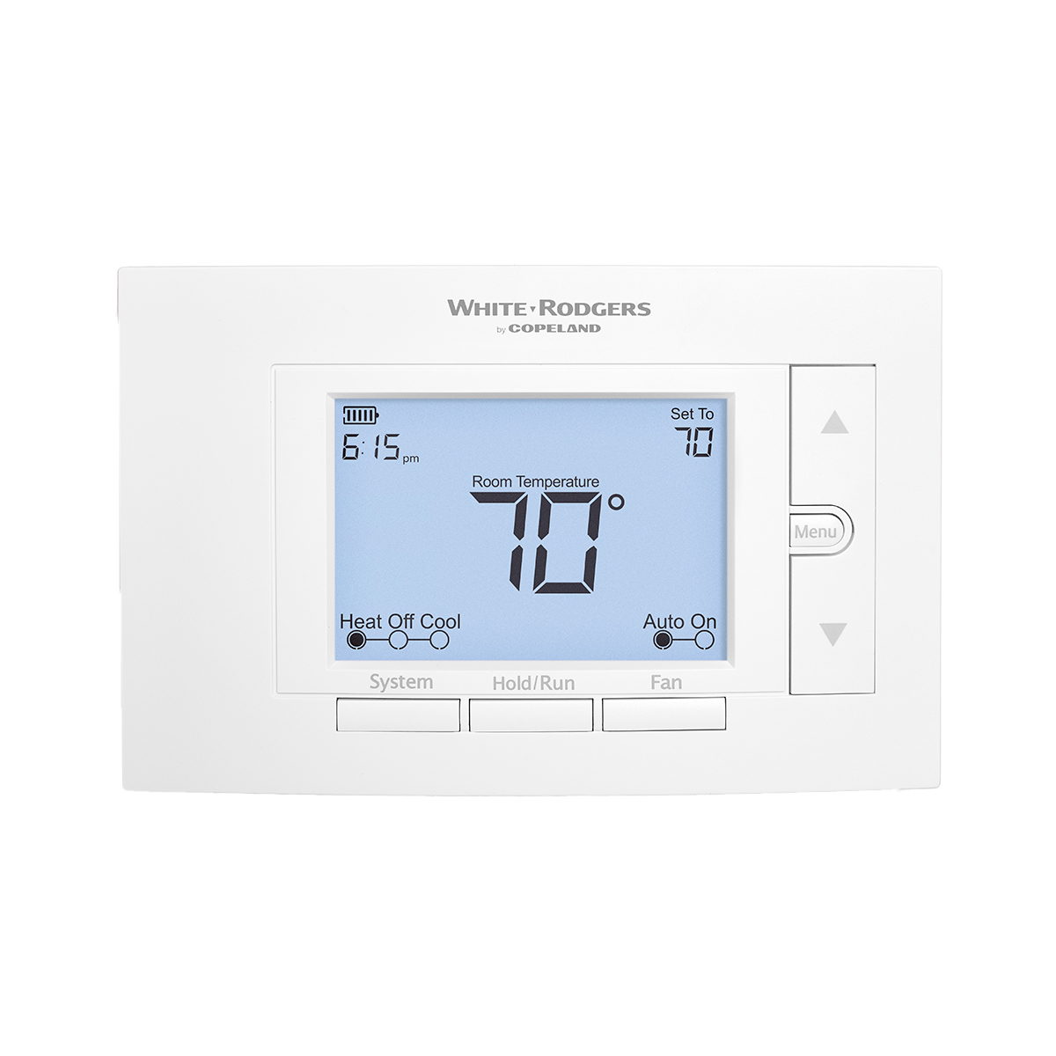
White-Rodgers Cross Reference
  Go to: https://webapps.copeland.com/wrproductselector/
    Enter the Model Number or click on: Search Replacement Heating Controls by Major OEM Brand

Slide 19

Why Contractors Trust White-Rodgers
Industry Leading Products
    Used by more OEM’s
    Offering the widest range of Universal
    Replacement Controls
Ease of Installation
    Simple, easy to understand instructions
Product Reliability
    Quality Control assures reliable products
Affordable
    Competitive pricing
Supported by Knowledgeable Representatives
    Contractor direct phone support

Slide 20
Installation Overview

Slide 21
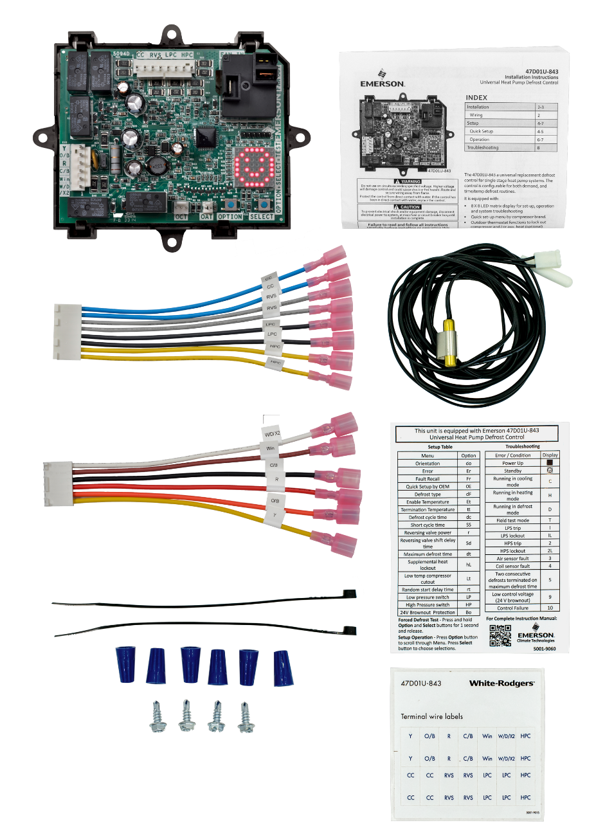

What’s In The Box?
Universal Heat Pump Defrost Control
    Includes universal plastic mounting tray + 4 screws
Thermostat Harness
    One harness, equipped with spades. Cut, strip, and wire nut if desired (included)
Heat Pump Harness
    Connect reversing valve, contactor, low and high pressure switches
Thermistors
    One to measure coil temp, and one to measure air temp
    Install air temp sensor for selectable lock out settings/ for use of demand defrost
Additional
    Zip Ties To manage harness locations
    Terminal wire stickers to label existing wires
    Setup and Troubleshooting label

Slide 22
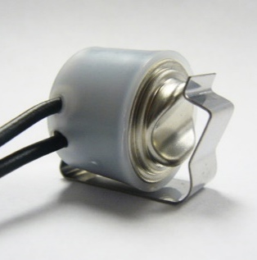
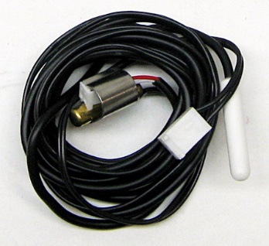
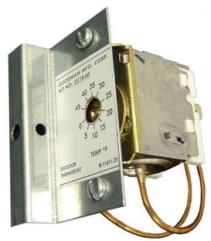
Integrated Value-added Features
Defrost Thermostat | Outdoor Heat-Pump Thermostat
The 47D01U-843 includes a new coil sensor and a new air temperature sensor. The old snap-disc coil sensor is upgraded to a thermistor type. | A built-in Outdoor Heat-Pump T/stat feature allows for Auxiliary Heat and Compressor Lock-outs. States like CA and NC are requiring this control to keep Electric back-up from coming on when it’s over 40°F outside.
✓
✓

Slide 23







Quick Set Up Configuration with Matrix LED
Simple Start-up Walk-through steps
Normal Status With Thermostat off, power up the system. The LED will light all segments and then show the standby smile
Select the Display Orientation Press the OPTION button until you see “do” which stands for “Display Orientation”
Adjust Orientation Press SELECT until the “Hi” characters are in the correct readable position. They move in 90° increments
Choose OEM Configuration Press the OPTION button 3 more times or until Original Equipment (OE) is displayed
Choose Pre-Configured OEM Settings Press SELECT until the correct OEM default number (1 through 8) appears (Reference to the OEM Quick Setup Options)
Press OPTION to confirm setting
Test Defrost Press and hold OPTION and SELECT at the same time for 1 second to initiate a test defrost cycle with forced defrost
Press Option (repeatedly) or wait 30 seconds for the standby smile to appear.

Slide 24
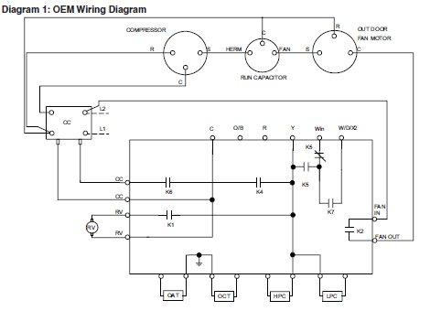
Installation & Wiring
  Refer to equipment manufacturer’s instructions for specific system wiring information. Wiring tables shown are for typical systems and describe the standard functions.
    Disconnect power to unit
    Label wires & take a picture of the current installation
    Remove existing control & remove wires
    Install replacement control secure with provided mounting screws in desired location
    Connect labeled thermostat wires to Thermostat Harness, then connect harness wires to the control
    Connect remaining labeled system wires to Heat Pump Harness (#2) and connect harness wires
    to the control
    Connect outdoor coil temperature sensor to
    the control
    Connect outdoor air temperature sensor to the control
    Connect high & low pressure switches to the control
5
6
7
Verify harness connection
8
9
  Please note:
    Air sensor should not touch unit cabinet.
    Coil sensor needs solid locating, e.g. place where original snap disc was located

Slide 25

Learn to install the 47D01U-843 Universal Defrost Control

Slide 26

Tech Tip: High Pressure and Low Pressure Monitoring and Fault Codes

Slide 27

Outdoor (OAT) and Coil (OCT) Sensor

Slide 28
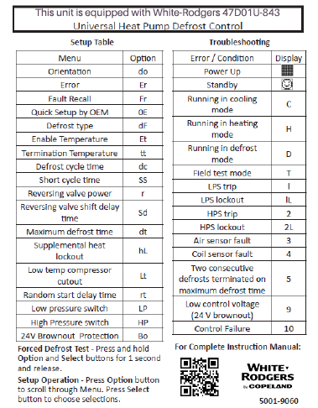
Troubleshooting
  White-Rodgers provides a Set-up & Troubleshooting
  sticker to place inside the unit for quick reference:
    Status Indicator
    Power up or stand by
      Heating / cooling / defrosting
      Test mode
        Provides a 30sec quick test to verify proper operation
    Troubleshooting
      Fault conditions present
      Highest priority and operating condition toggling
      Remaining errors “ER” menu
      Correct condition to remove errors
    Recall Historical Data
      Recall up to last four faults

Slide 29
Thank you.
R-5057-2. ©2024 Copeland LP.

